Slide 1
Advanced Front-End Programming (CPAN 144)
Week 5
Lecturer: Harshdeep Singh
Summer 2024

Slide 2
Agenda
Component State
Component Props
Events and Event Handling
Hooks

Slide 3
Props
Props(short for Properties) are the information that you pass to a JSX tag. For example, className, src, alt, width, and height are some of the props you can pass to an <img>:

Slide 4
Props
The props you can pass to an <img> tag are predefined (conforming to the HTML standard).
But you can pass any props to your own components, such as <Avatar>, to customize them.
Props are Read-Only, Your component must never modify its props
Example:
function Avatar() {
return (
<img
className="avatar"
src="https://i.imgur.com/1bX5QH6.jpg"
alt="Lin Lanying"
width={100}
height={100}
/>
);
}

Slide 5
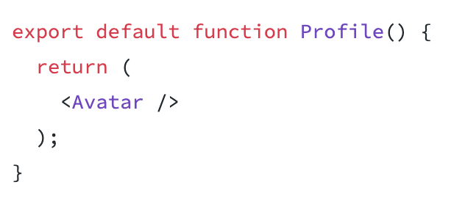
Passing props to a component
In this code, the Profile component isn’t passing any props to its child component, Avatar:
You can give Avatar some props in two steps.

Slide 6
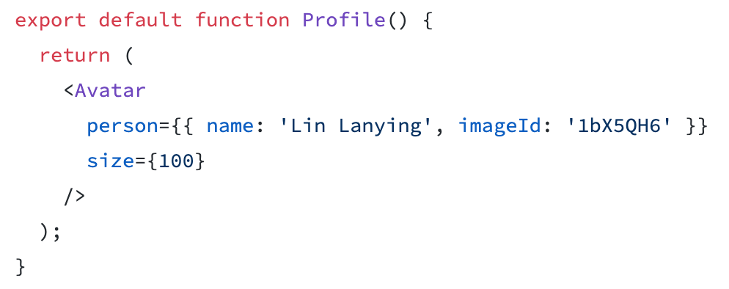
Step 1: Pass props to the child component
First, pass some props to Avatar. For example, let’s pass two props: person (an object), and size (a number):
If double curly braces after person= confuse you they’re merely an object inside the JSX curlies.

Slide 7
Step 2: Read props inside the child component
export function getImageUrl(person, size = 's') {
return (
'https://i.imgur.com/' +
person.imageId +
size +
'.jpg'
);
}
You can read these props by listing their names person, size separated by the commas inside ({ and }) directly after function Avatar. This lets you use them inside the Avatar code, like you would with a variable.
function Avatar({ person, size }) {
return (
<img
className="avatar"
src={“https://i.imgur.com/” + person.imageId +”.jpg”}
alt={person.name}
width={size}
height={size}
/>
);
}

Slide 8
Events

Slide 9
Adding event to the Component
Just like HTML, React can perform actions based on user events.
React events are written in camelCase syntax:
onClick instead of onclick.
React event handlers are written inside curly braces:
onClick={shoot} instead of onClick="shoot()".

Slide 10
Example
function Football() {
function shoot() {
alert("Great Shot!");
}
return (
<button onClick={this.shoot}>Take the shot!</button>
);
}

Slide 11
Activity 1
Take the example on the previous page and add additional buttons that generate different alert messages.

Slide 12
State: A component’s memory
Components often need to change what’s on the screen as a result of an interaction.
Example:
- Typing into the form should update the input field
- clicking “buy” should put a product in the shopping cart

Slide 13
State
Components need to “remember” things: the current input value, the current image, the shopping cart.
In React, this kind of component-specific memory is called state

Slide 14
State vs regular variables
Here’s a component that renders a number from a variable. Clicking the “Increment” button should add to the number and show it on the screen (Let’s try it):
export default function App() {
let number = 1;
function increment() {
number = number + 1;
console.log(`The current number inside the function is ${number}`);
}
return (
<div className="App">
<h1>The current number in the component is {number}</h1>
<button onClick={increment}>Increment</button>
</div>
);
}

Slide 15
Why won’t it change?
The “increment” event handler is updating a local variable, number. But two things prevent that change from being visible:

Slide 16
Why won’t it change?
Local variables don’t persist between renders: When React renders this component a second time, it renders it from scratch—it doesn’t consider any changes to the local variables.
Changes to local variables won’t trigger renders: React doesn’t realize it needs to render the component again with the new data.

Slide 17
Why won’t it change?
To update a component with new data, two things need to happen:
Retain the data between renders
Trigger React to render the component with new data (re-rendering).

Slide 18
useState() hook
The useState Hook provides those two things:
A state variable to retain the data between renders.
A state setter function to update the variable and trigger React to render the component again.

Slide 19
Adding a state variable
To add a state variable, import useState from React at the top of the file:
import { useState } from 'react';
Then, replace this line:
let number = 1;
with:
const [number, setNumber] = useState(1);

Slide 20
Adding a state variable
const [number, setNumber] = useState(1);
number is a state variable and setNumber is the setter function.

Slide 21
This is how they work together in the increment function:
function increment() {
setNumber(number + 1);
}
Now clicking the “Increment” button increments the number on the screen

Slide 22
Here’s how it happens in action:
const [number, setNumber] = useState(1);
Your component renders the first time. Because you passed 1 to useState as the initial value for number, it will return [0, setNumber]. React remembers 1 is the latest state value.
You update the state. When a user clicks the button, it calls setNumber(number + 1). number is 1, so it’s setNumber(2). This tells React to remember number is now 2 and triggers another render.
Your component’s second render. React still sees useState(1), but because React remembers that you set number to 2, it returns [2, setNumber] instead.
And so on!

Slide 23
Introducing Hooks
In React, useState, as well as any other function starting with “use”, is called a Hook.
Hooks are functions that let you “hook into” React features

Slide 24
Submit your class Activities
Navigate to Course Content -> Assessments -> Labs -> Lab 5 and download the instruction for lab 5.
Once you fulfill all the requirements of the lab, ZIP all your source files and submit them into Course Content -> Assessments -> Labs -> Lab 5
Pay attention to the due date defined on the blackboard submission box for this activity.

